Slide 1
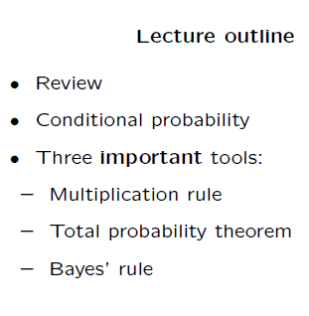
Lecture-2: Conditional Probability

Slide 2
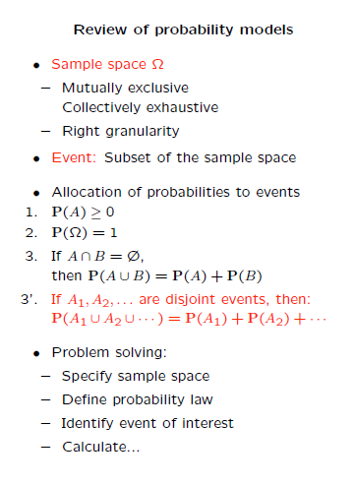

Slide 3
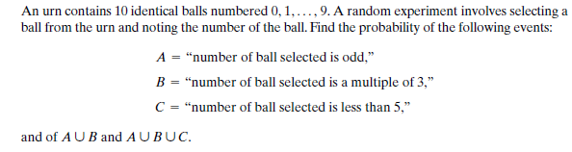

Slide 4
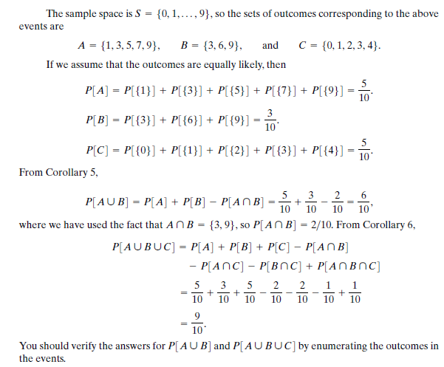

Slide 5
Conditional Probability
Conditional probability provides us with a way to reason about the outcome of an experiment, based on partial information
Example:
Let all 6 possible outcomes of a fair die roll are equally likely. What is the prob. that outcome is 6 when we are told that the outcome is even.

Slide 6
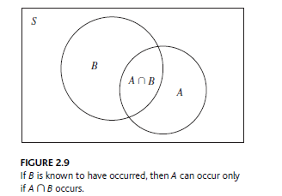

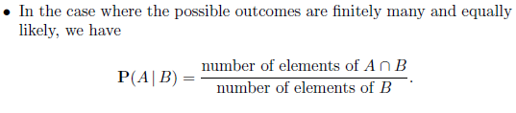


Answer
If we are told that the outcome is even, we are left with only three possible outcomes, namely, 2, 4, and 6. These three outcomes were equally likely to start with, and so they should remain equally likely given the additional knowledge that the outcome was even.
$$=$$

Slide 7
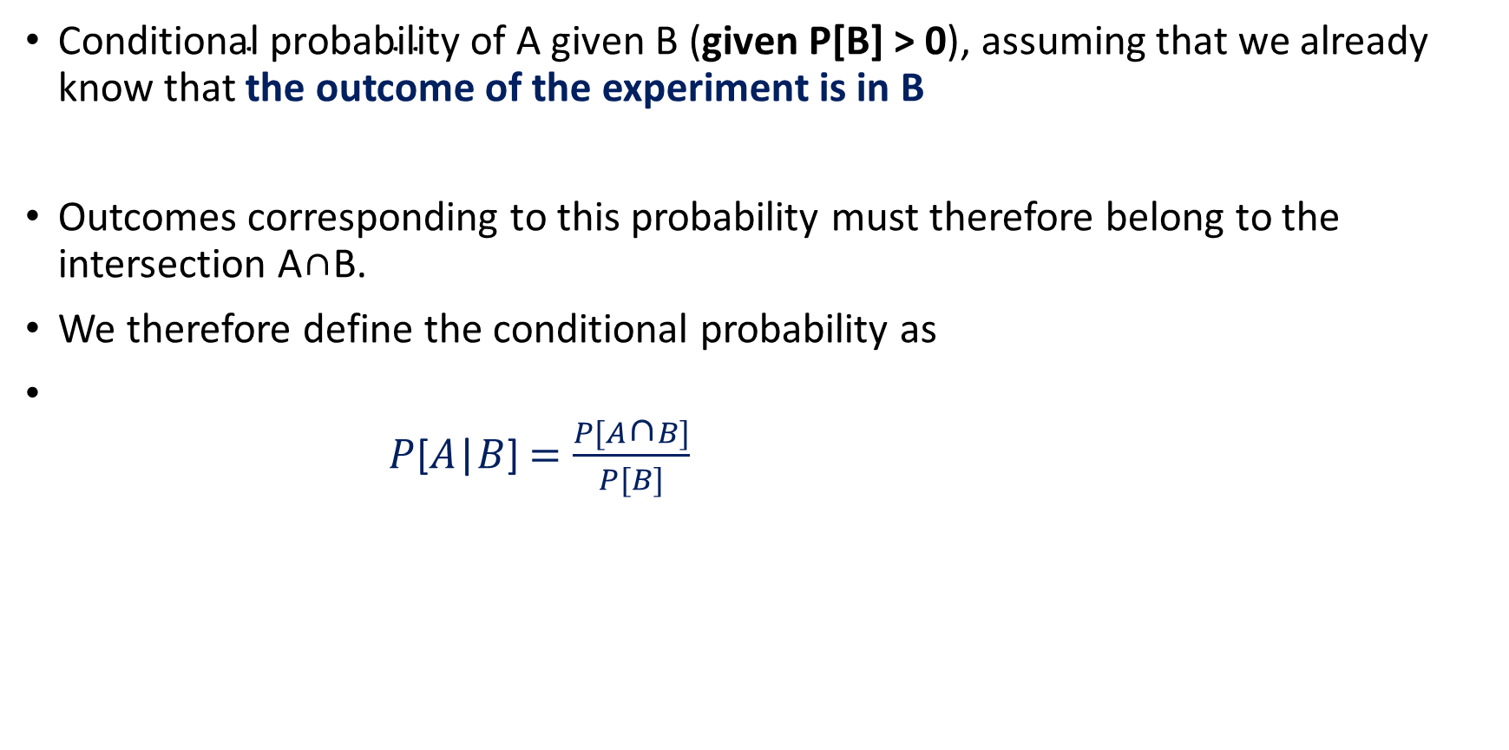
Conditional Probability-Definition
$\text{Conditional} \text{probability} \text{of} \text{A} \text{given} \text{B}\text{ (}\text{given} \text{P}\text{[}\text{B}\text{] > 0}\text{)}$, assuming that we already know that the outcome of the experiment is in B
Outcomes corresponding to this probability must therefore belong to the intersection A∩B.
We therefore define the conditional probability as
$P$[$A$|$B$]$=\frac{P[A\text{∩}B]}{P[B]}$

Slide 8


P(A|B) form a legitimate probability law that satisfies the three axioms
Non-negativity property is obvious.
Additivity:
$$P\text{[}A_{1}\text{⋃}A_{2}|B\text{]} =P\left[A_{1}|B\right]+P\left[A_{2}|B\right]−P[A_{1}\text{∩}A_{2}|B]$$
Prove it!
Conditional probabilities behave just the same as regular probabilities, since all we are doing is restricting the sample space to the event being conditioned on

Slide 9
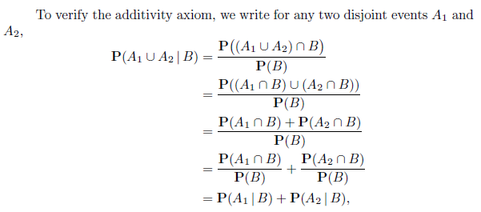

Slide 10
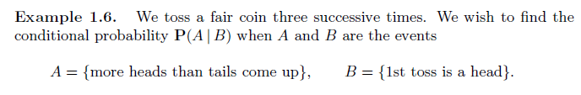

Slide 11

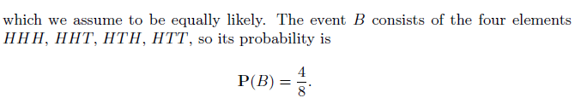
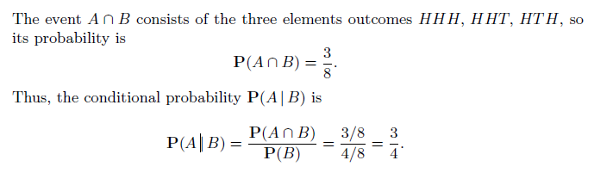

Slide 12
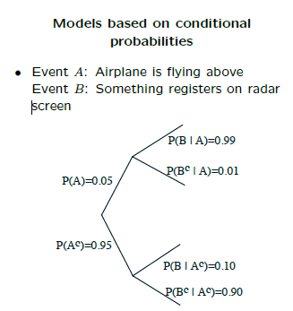
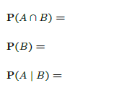

Slide 13
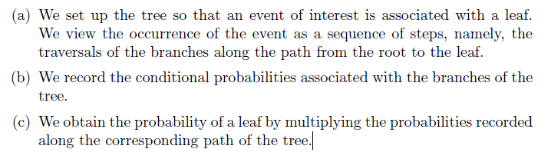
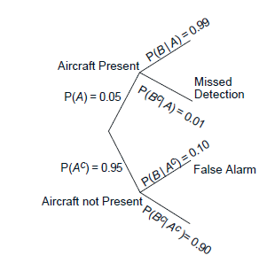
Tree-based sequential description

Slide 14
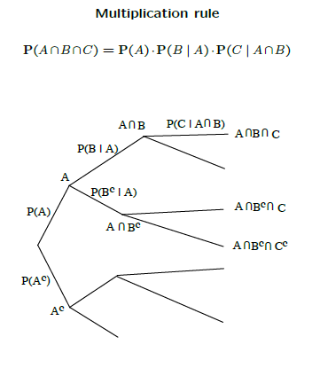
We associate the branches of this path with the events A, B, C, and we record next to the branches the corresponding conditional probabilities

Slide 15
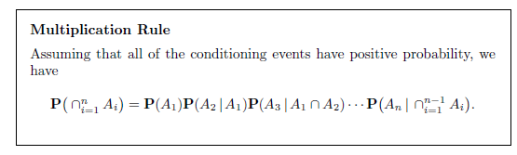
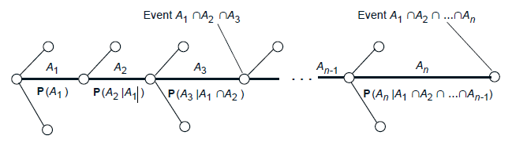

Slide 16
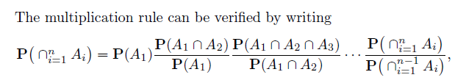
Proof

Slide 17
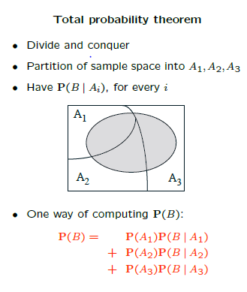
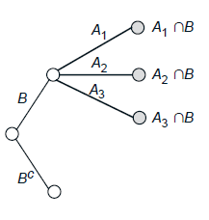

Slide 18
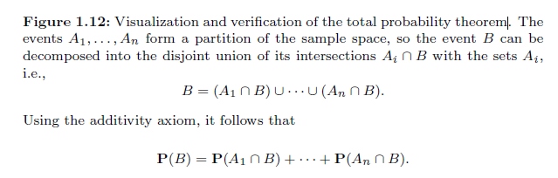
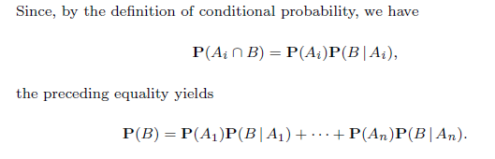
Visualization of the Total Probability Theorem

Slide 19
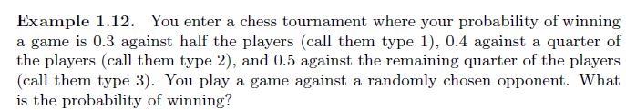
Ex.

Slide 20

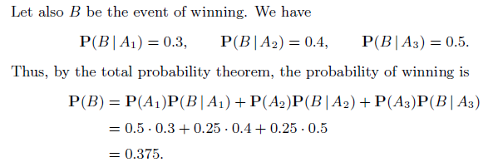
Solution

Slide 21
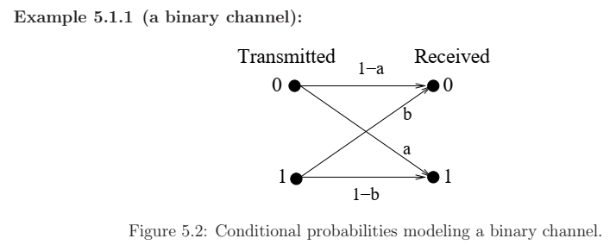
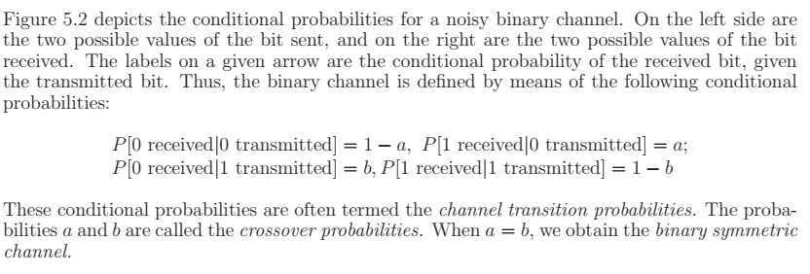

Slide 22
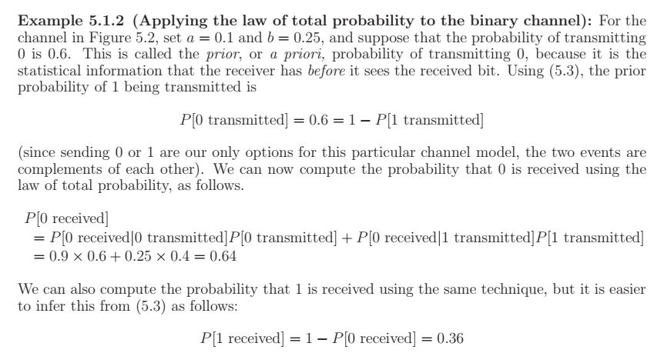
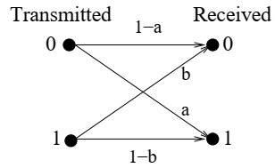
= 0.25
= 0.1

Slide 23
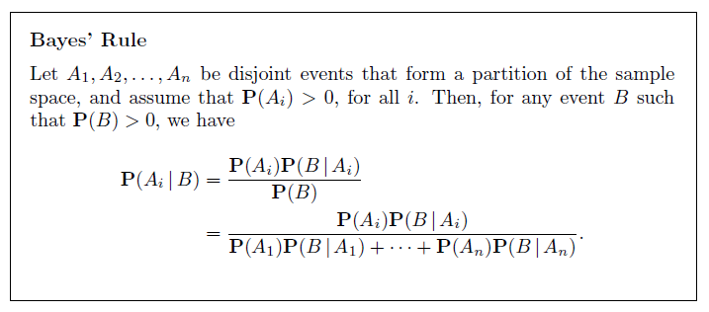
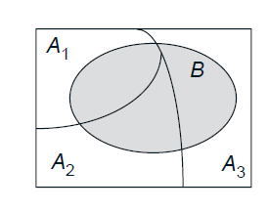

Baye’s Rule
Given $likelihood functions$ $P\left(B | A_{i}\right)$ and a priori probabilities $P(A_{i})$, for all $i$, we can compute a posteriori probability$P\left(A_{i} | B\right)$ by using Baye’s rule
INFERENCE problem: a problem where we need to infer something that can’t be observed directly

Slide 24

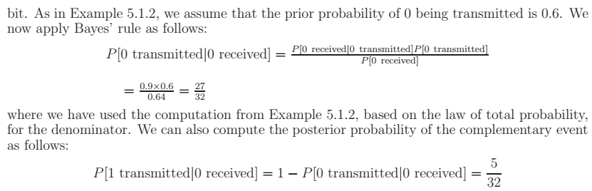

Slide 25
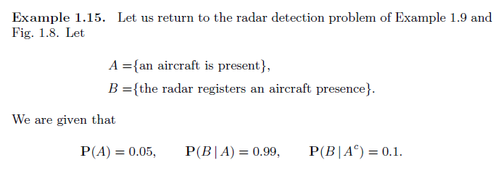
Compute this probability P(A|B).

Slide 26
